Slide 1
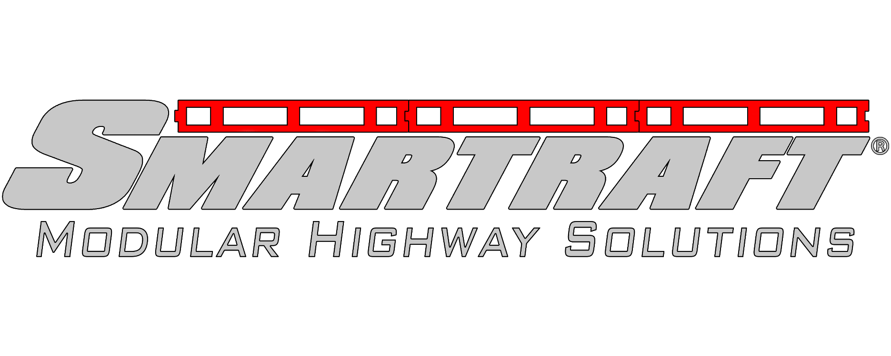
Hydroraft & VRS Hydroraft
Drainage & VRS Integration
INNOVATION
AND
Performance you can depend on

Slide 2
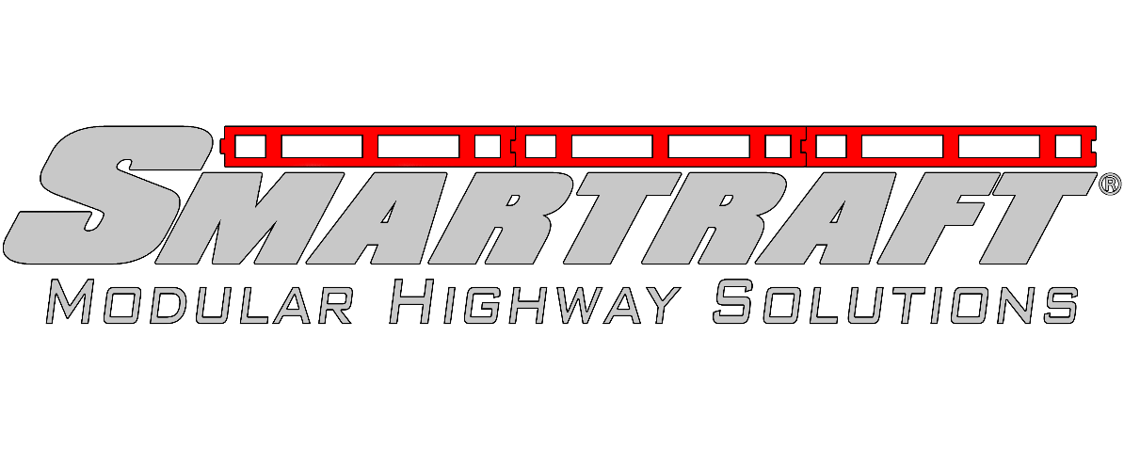
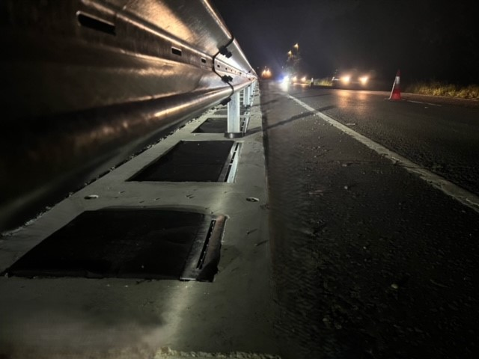
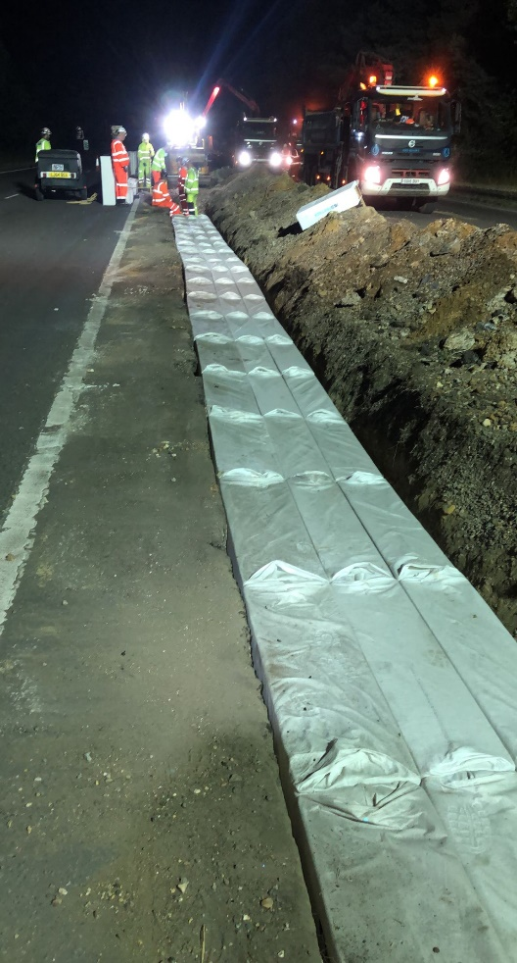
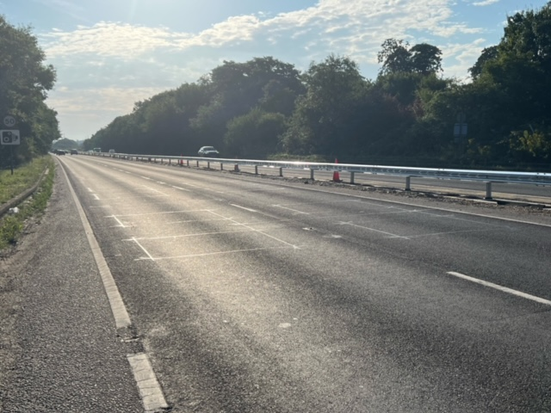
Work Smarter Not Harder with Smartraft®
Overview
Hydroraft can be supplied with the ability to incorporate VRS systems or as a load bearing drainage system installed without VRS.
Hydrorock is reliable and maintenance friendly system with a life span of 50 years.
As the Hydrorock block is wrapped in a geotextile, root infiltration is not a problem, root growth does not have a negative effect on the operation of the system.
Removes Pollutants from road runoff: 80% of Suspended Solids; 70% Oil & PAHs; 80% Copper; 51% Zinc, and facilitates removal of dissolved metals / solids / fertilisers / nitrates
End of Life- Product fully recyclable
Hydrorock maintains the natural water cycle
Easy to inspect & clean
A combined system for VRS & drainage installations.

Slide 3
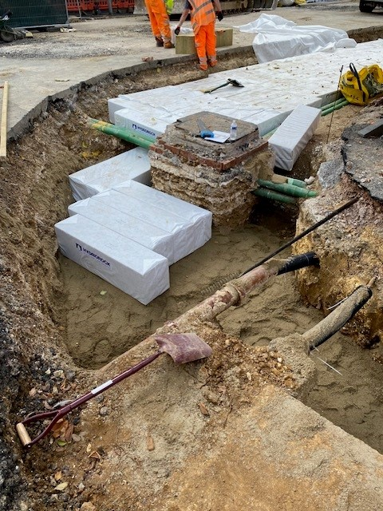
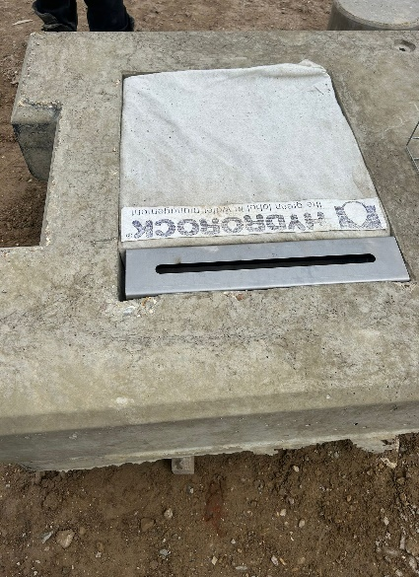
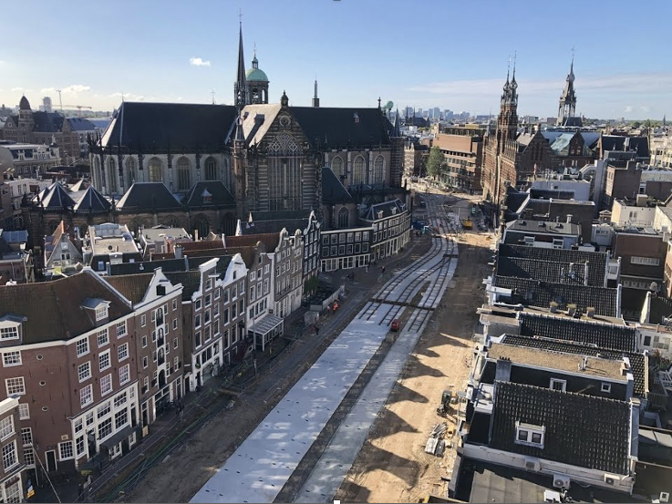
Work Smarter Not Harder with Smartraft®
The challenge- Drainage in highways
Deliverability (project risk)
Problem- 95% of drainage projects go off plan when ground is opened.
Challenge- Ensuring projects are completed on time & within budget
Solution- Hydroraft provides total flexibility during configuration & installation
Maintainability
Problem- Conventional filter stone requires costly maintenance
Challenge- Minimising & simplifying maintenance
Solution- Hydroraft systems are designed to minimise maintenance by reducing inspection, removing the need for periodical remediation, repairs, or replacement.
Reliability
Problem- Conventional drainage does not always perform as required
Challenge- Providing a drainage solution that works all the time.
Solution- Hydroraft systems are designed for whole life cost, they are high porosity, permeable & non clogging
Image below shows Hydrorock installed under Amsterdam transport infrastructure.

Slide 4
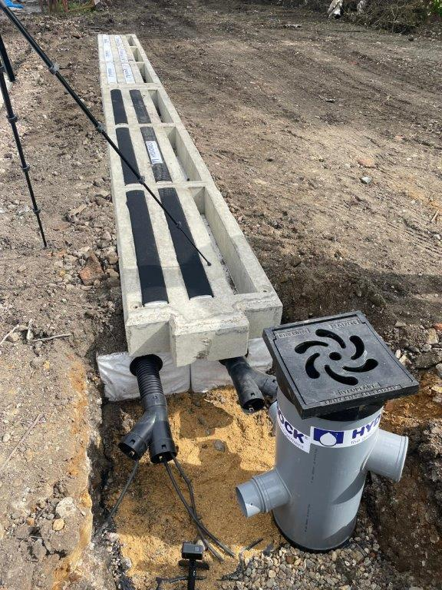
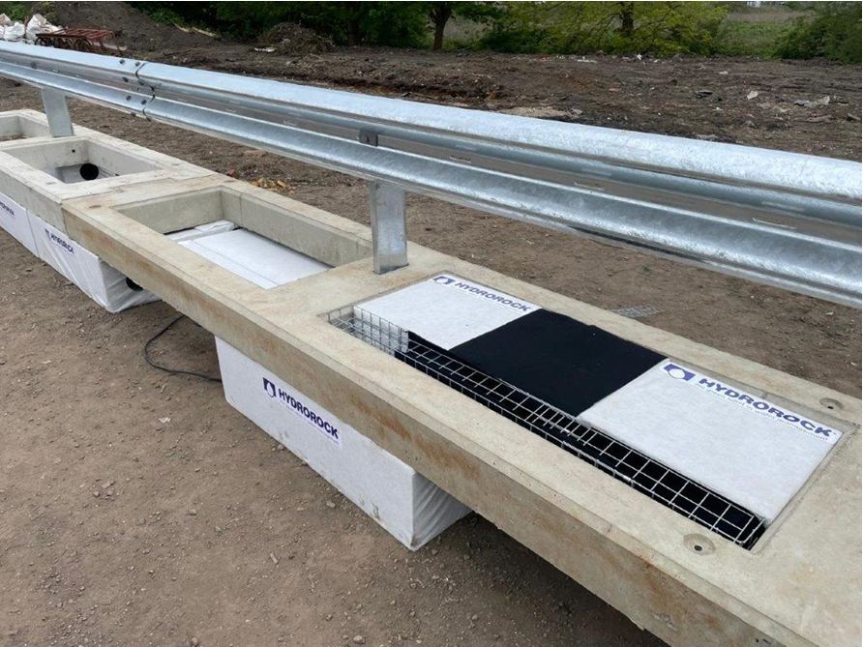
Work Smarter Not Harder with Smartraft®
What is Hydroraft?
Hydroraft is a combination of the proven modular highways foundation- Smartraft® integrating a product called “Hydrorock” to provide improved drainage systems on our highways.
Hydroraft can be supplied with the ability to incorporate VRS systems & as a load bearing drainage system installed without VRS.
Hydrorock is manufactured from a natural material “Basalt” and is made by an international company Rockwool.

Slide 5
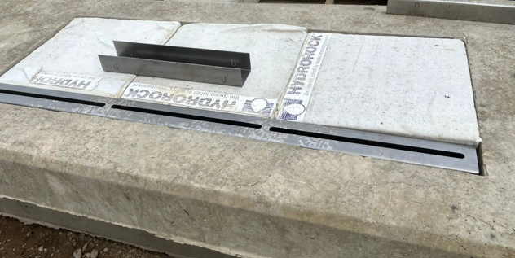
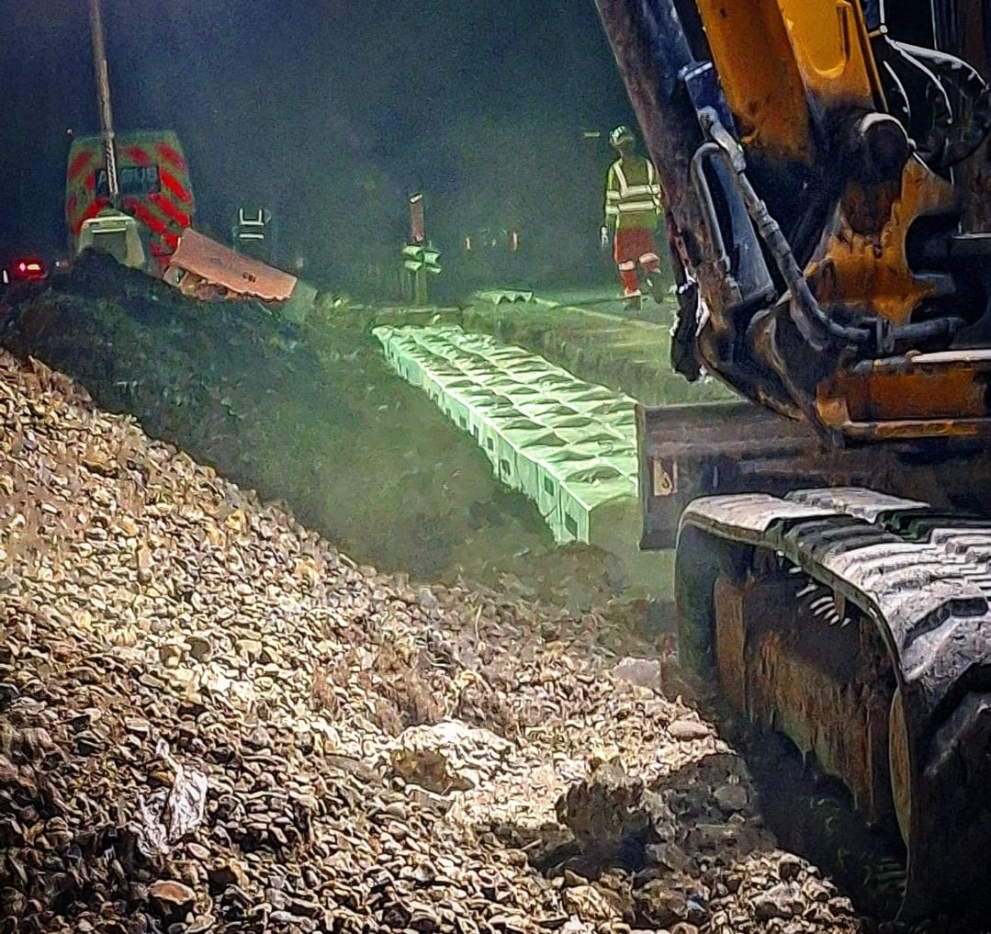
Work Smarter Not Harder with Smartraft®
Durability with Hydroraft Hydrorock
Hydrorock is a reliable and maintenance friendly system with a life span of 50 years.
The inherent properties of the product do not deteriorate over time, even under the influence of oxygen, heat, frost, sunlight & the effects of chemical substances such as acids, alkali, oils and fats.
There are no issues with compression & settlement, even under heavy loads (20t axle loads). This makes it ideal for beneath roads, buildings, tramlines or carparks.
Approx 1% consolidation occurs during installation, with less than 2% deformation over 30 years. Making the product stable in shape & size throughout its entire life span.
Root infiltration is not a problem, root growth does not have a negative effect on the operation of the system.
Easy to inspect & clean. After some time, sediment such as silt, sand or organic material can collect in the silt tray. By carrying out periodic inspections and cleaning the silt tray will ensure optimum condition.

Slide 6

Work Smarter Not Harder with Smartraft®
Environmental Performance
Hydrorock maintains the natural water cycle
Current drainage practice often breaks Natural Water Cycles by:
Increasing urban flooding.
Overpowering sewers and water treatment facilities.
Damaging the natural ecology of the soil.
Polluting rivers with toxic chemicals.
Burying unnecessary plastic in the ground.
Hydrorock natural aquifer solutions
Use natural materials.
Work with rainfall where it lands.
Manage surface water fully onsite.
Enable ultra efficient natural infiltration.
Create natural-type aquifers wherever they are needed
Removes Pollutants from road runoff: 80% of Suspended Solids; 70% Oil & PAHs; 80% Copper; 51% Zinc, and facilitates removal of dissolved metals / solids / fertilisers / nitrates
When built into water control infrastructure,
Hydrorock safely stores incredible quantities of excess rainwater, before releasing it back to nature
Safe for the soil
The material is inert, does not degrade and has an expected life span of 50 years.
End of Life
Product fully recyclable

Slide 7
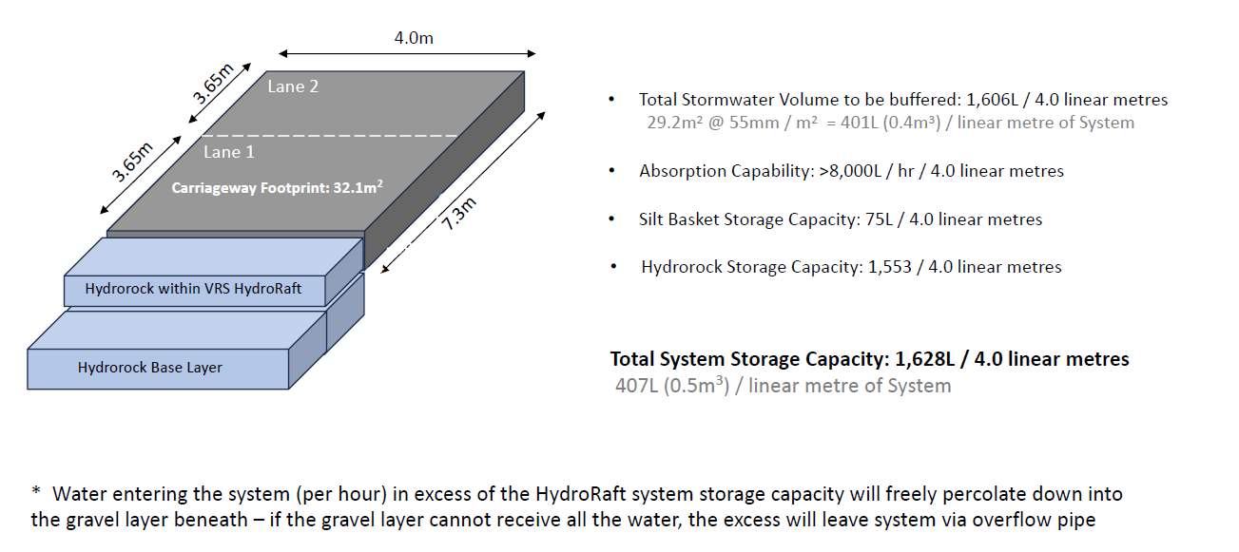
Work Smarter Not Harder with Smartraft®
Drainage Performance
Drainage performance of Hydroraft + Hydrorock (Infill & Base layer)
1 in 30-year rain event totaling 50mm/m2 from a 2-lane carriage way within 1 hour

Slide 8
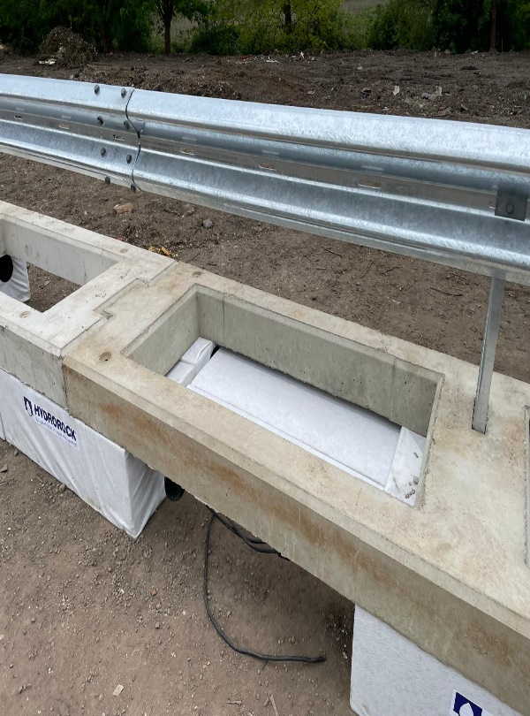
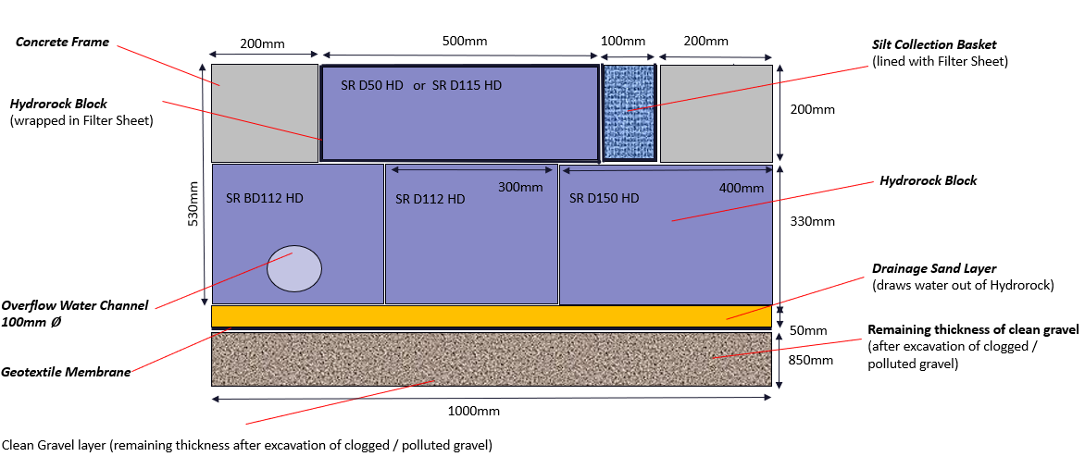
Work Smarter Not Harder with Smartraft®
Section View of VRS Smartraft + Hydrorock (Infill & Base Layer)
Capacity of water/ 6m length= 2270 litres
Notes:
Capacity of water calculated at-
Beneath Smartraft- 5nr 150litre blocks= 750 litre
Beneath Smartraft- 10nr 112litre blocks= 1120 litre
In apertures of Smartraft 6m
Tank Volume Calculator (calculatorsoup.com)
500mm * 500mm *200mm Hydrorock blocks= 50 litre * 2 = 100 litres
1500mm * 500mm * 200mm Hydrorock blocks= 150 litres 2 = 300 litre
Total= 750 + 1120 + 100 + 300 =

Slide 9
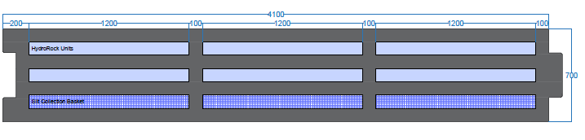
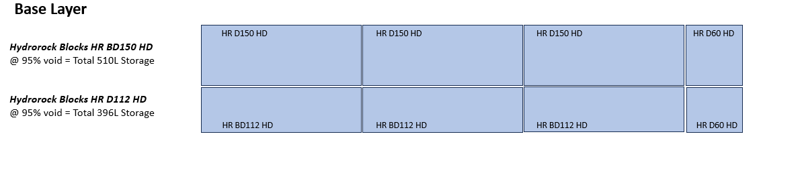
Work Smarter Not Harder with Smartraft®
Layout configurations- Without VRS
Top Layer
Silt Collection Baskets
(Lined with Filter Sheet)
@ 100% void = Total 75L Storage
Hydrorock Blocks HR D25 HD
(Wrapped In Filter Sheet)
@ 95% void = Total 138L Storage

Slide 10
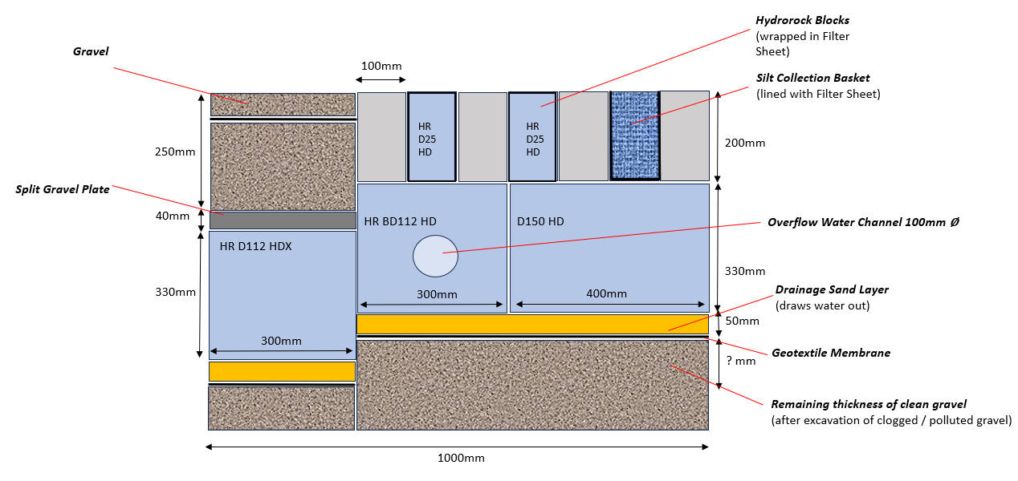
Work Smarter Not Harder with Smartraft®
Section View of HydroRaft + Hydrorock (Infill & Extended Base Layer)
Capacity of water/ 6m length= 2120 litres
Notes:
Notes-
Capacity of water calculated at-
Beneath Smartraft- 5nr 150litre blocks= 750 litre
Beneath Smartraft- 10nr 112litre blocks= 1120 litre
In apertures of Smartraft-
10 nr 25 litre Hydrorock blocks- 250 litres
Total- 2120 litres

Slide 11
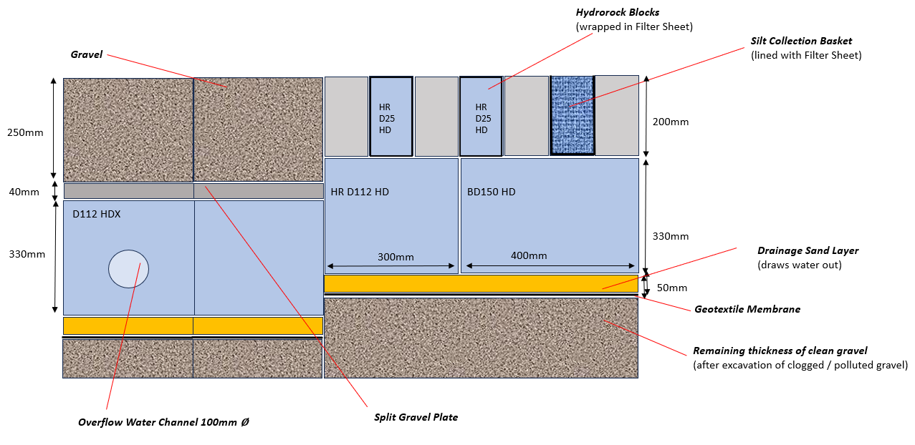
Work Smarter Not Harder with Smartraft®
700mm HydroRaft With Double Extended Base
Capacity of water/ 6m length= 2680 litres
Notes:
Notes-
Capacity of water calculated at-
Beneath Smartraft- 5nr 150litre blocks= 750 litre
Beneath Smartraft- 15nr 112litre blocks= 1680litre
In apertures of Smartraft-
10 nr 25 litre Hydrorock blocks- 250 litres
Total- 2680 litres

Slide 12
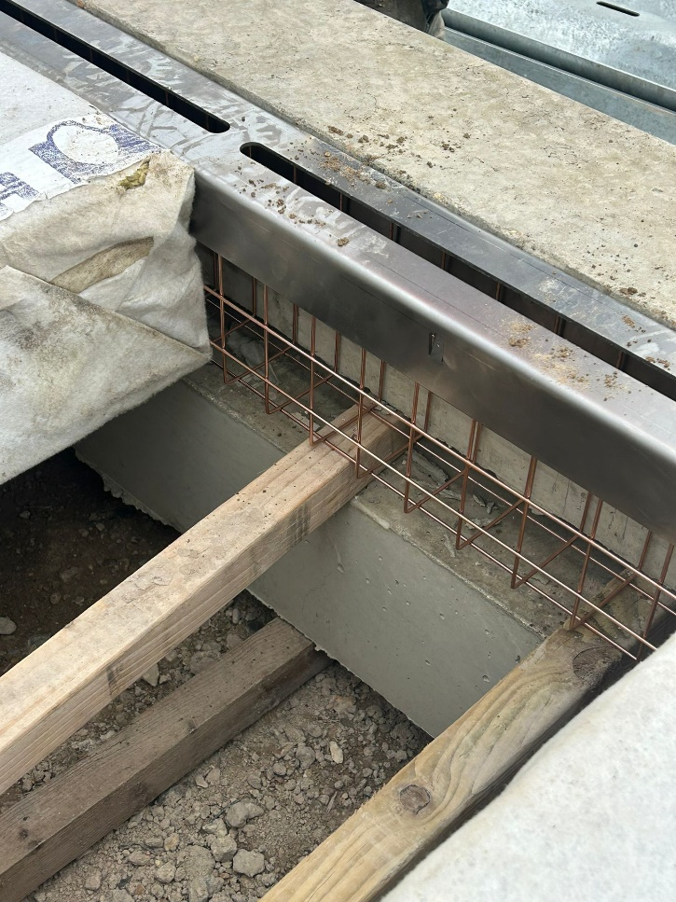
Work Smarter Not Harder with Smartraft®
Silt collection Tray
A silt collection tray is inserted in the Hydroraft before the initial Hydro block. The silt collection tray prevents, soils, sediments & metals from entering the Hydrorock drainage system.
After installation, periodic cleaning of the silt collection tray will need to be conducted. This can be conducted in line with cyclical maintenance of VRS systems.
The image shown on the left, demonstrates the construction of the silt Collection tray. When installed the unit is wrapped in geotextile, to collect the silts.
Unlike conventional systems, any silt run of collecting on the road edge can be easily swept with a road sweeper.
Silt collection tray is manufactured from mild steel & galvanised to ISO 1461. Anticipated lifespan of silt collection tray 25 years based on atmospheric conditions in line with the galvanic corrosion table.

Slide 13
Work Smarter Not Harder with Smartraft®
Summary
Hydroraft can be supplied with the ability to incorporate VRS systems or as a load bearing drainage system installed without VRS.
Hydrorock is reliable and maintenance friendly system with a life span of 50 years.
As the Hydrorock block is wrapped in a geotextile, root infiltration is not a problem, root growth does not have a negative effect on the operation of the system.
Removes Pollutants from road runoff: 80% of Suspended Solids; 70% Oil & PAHs; 80% Copper; 51% Zinc, and facilitates removal of dissolved metals / solids / fertilisers / nitrates
End of Life- Product fully recyclable
Hydrorock maintains the natural water cycle
Easy to inspect & clean
A combined system for VRS & drainage installations.

Slide 14
INNOVATION
AND
Performance you can depend on
If you would like to understand how Smartraft® can help you on your next project, or have any questions please do not hesitate to contact-
Kevindavies@smartraft.co.uk for further details

